Slide 1
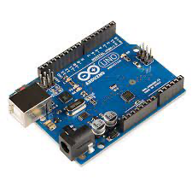
Arduino Hardware and IDE

Slide 2
What is Arduino?
An Arduino is an open-source hardware development platform used to develop easy-to-use electronic devices to interact with the real world. The hardware configuration of an Arduino is open source which means that it can be modified in order to make different versions of itself.

Slide 3
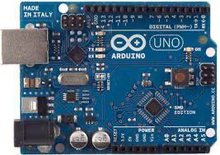
Arduino UNO
An Arduino UNO is an open-source microcontroller board which is based on Atmega328p. It is a standard board of Arduino which is easy to operate in comparison to other Arduino boards. Along with 14 digital input/output pins, six of which are analog input pins, the board also has a USB port, reset button, ICSP header, and other components. The Arduino UNO board already has these components loaded, and we can utilize them in your project. The board's USB port or its DC power supply can both be used to charge the gadget and feed/receive the data from it.

Slide 4
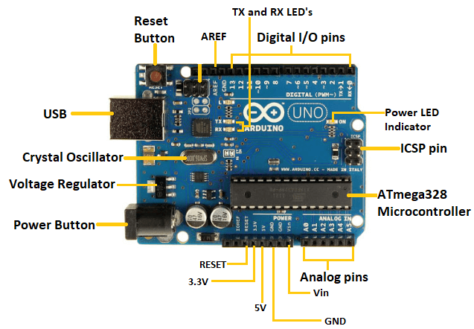
Components of Arduino UNO

Slide 5
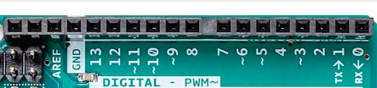
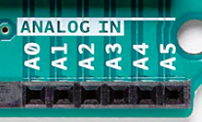

Components of Arduino UNO
Digital input/output pins
There are a total of 14 digital pins in Arduino Uno where 6 pins (3,5,6,9,10,11) support PWM(pulse width modulation). It has the two- state values 0 and 1 (low and high).
2) Analog pins
There are a total of 6 analogue pins (A0-A5) which are used to read the range of continuous value from an analog sensor like LDR. It can read the voltage value from 0-5 V
3) Power supply pins
For supplying the power to input and output component

Slide 6
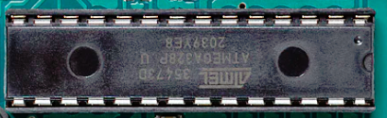
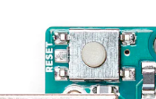

Component of Arduino UNO
4) Microcontroller
It is the main component of an Arduino UNO board which is based on ATmega328. It is the brain of an Arduino UNO as it combines storage, CPU, etc.
5) Reset button
The reset button is used for disconnection the board
To the power supply or executing the instruction from
Beginning
6) TX and RX LED
When the data is transmitted or received from
The computer to Arduino board through USB serial
port the Tx and Rx LED Blinks

Slide 7

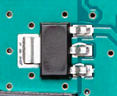

Components of Arduino UNO
7) Crystal Oscillator
It helps the calculation of time and sychniziation of an internal operation for making the board powerful. It has a frequency of 16 MHZ.
8) Voltage regulator
The voltage regulator converts the input voltage to 5V in the Arduino UNO board for a steady voltage supply
9) ICSP(In-circuit Serial programming) pins
These pins are used to code and boot an Arduino from an external source. It is used to program two microcontrollers.

Slide 8


Component of Arduino UNO
10) AREF(Analog Reference)
It is used to provide an external reference voltage for analog- to –digital conversion of input to analog pins
11) USB
It allows for the connection between Arduino board and computer.
12) ATmega16U2
It acts as a bridge between the computer USB port and the serial port

